Slide 1
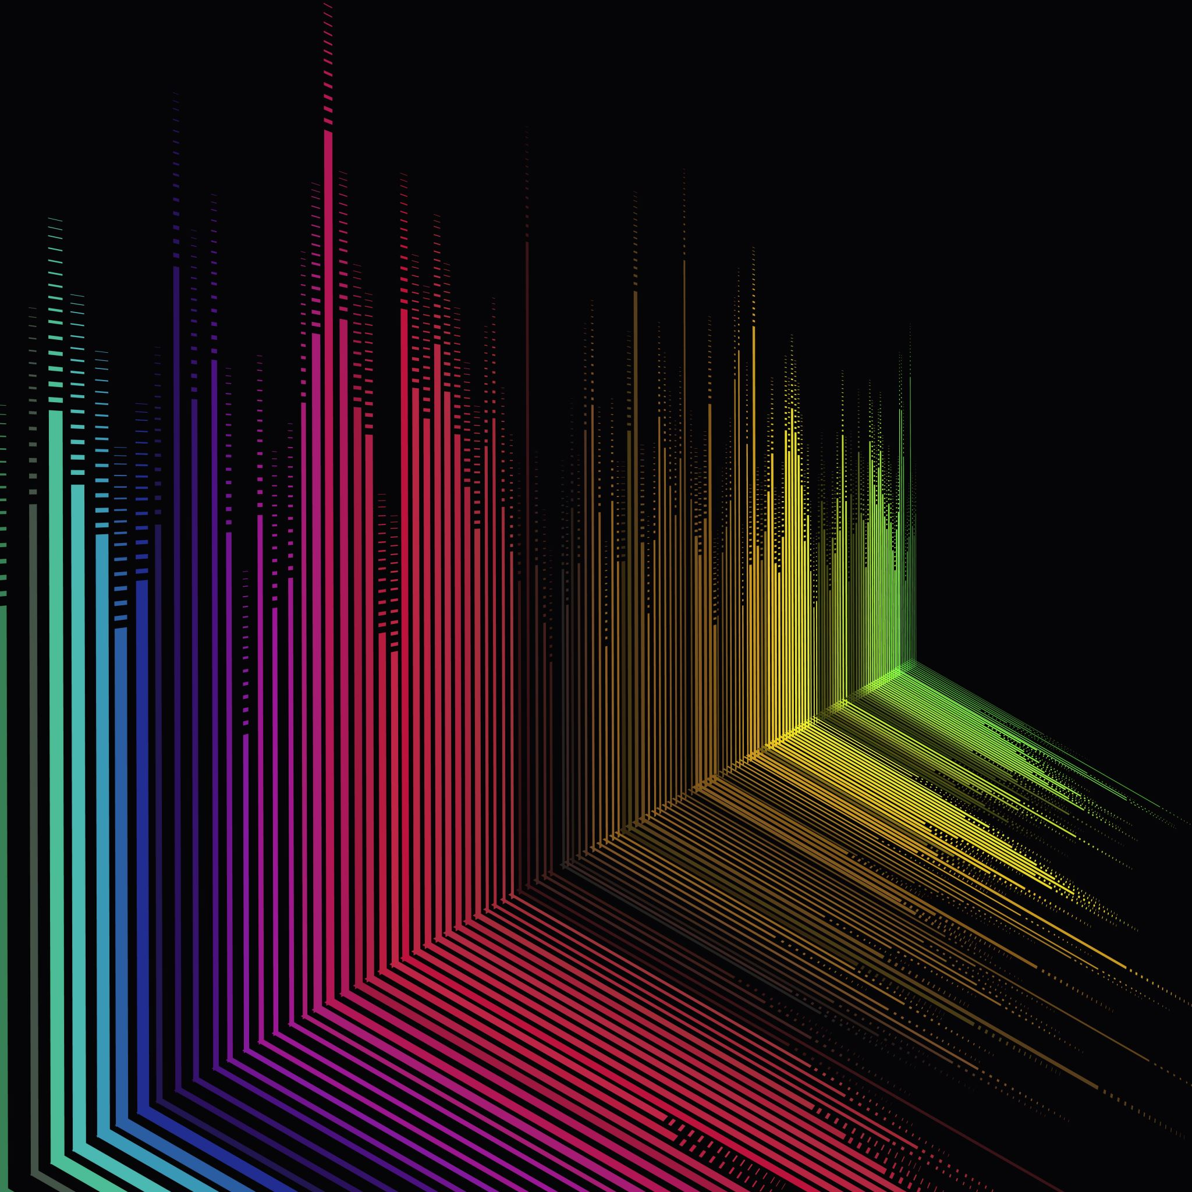
STCV-Synth
DGMD-E14 – Final Project
Harvard Extension School
Fall 2021
David Cardona
Robert Fischer

Slide 2
Agenda
Description
Demo
Architecture
Engine
Controllers
Data Analysis
Resources
Conclusions

Slide 3
Description

Slide 4
STCV-Synth
First prototype in a series of accessible devices for creative expression
Audio engine controlled by a 9-DOF IMU and Computer Vision

Slide 5
Purpose
Create artistic outlets for people with disabilities
Novel interactive interdisciplinary art performances

Slide 6
Demo

Slide 7
Architecture

Slide 8
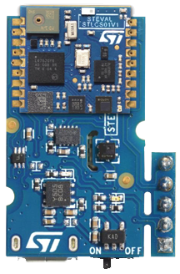

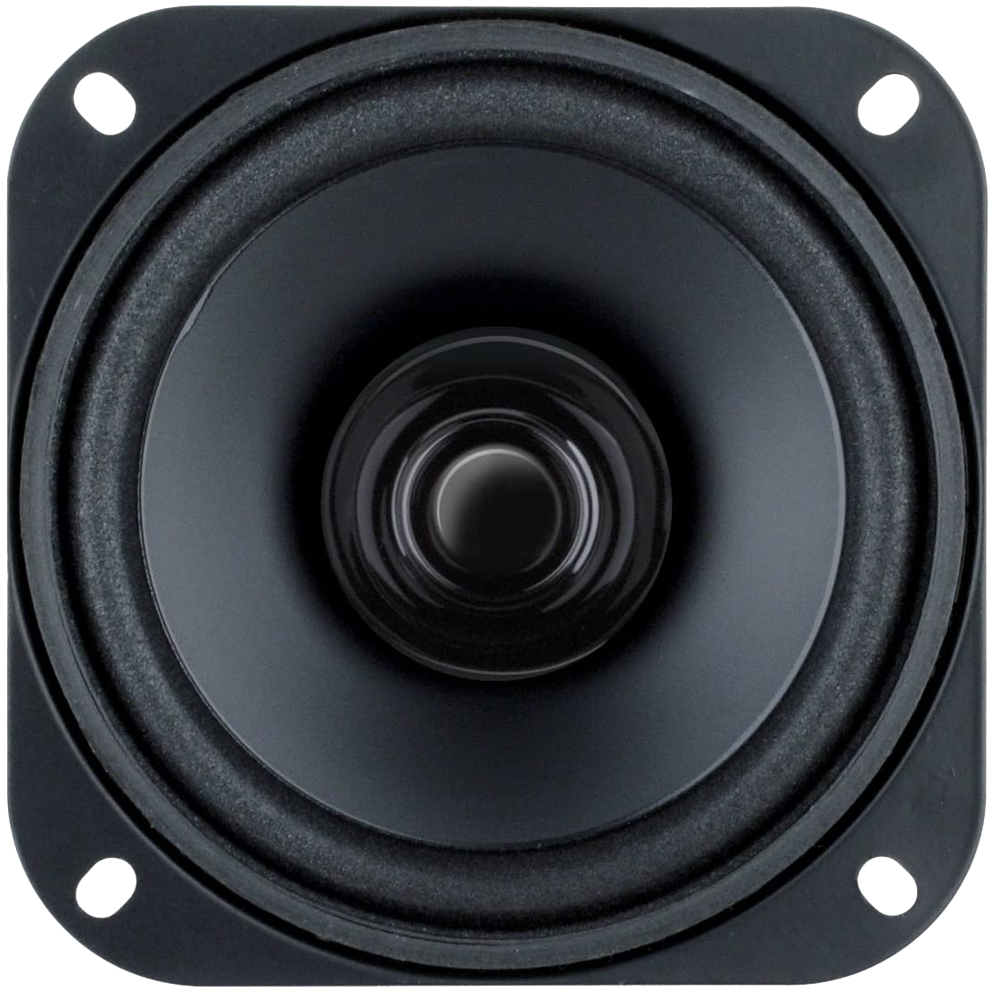
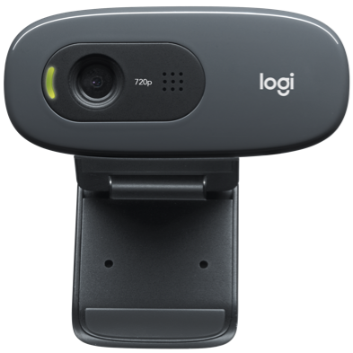
MacOS – Linux – Windows
BLE

Slide 9
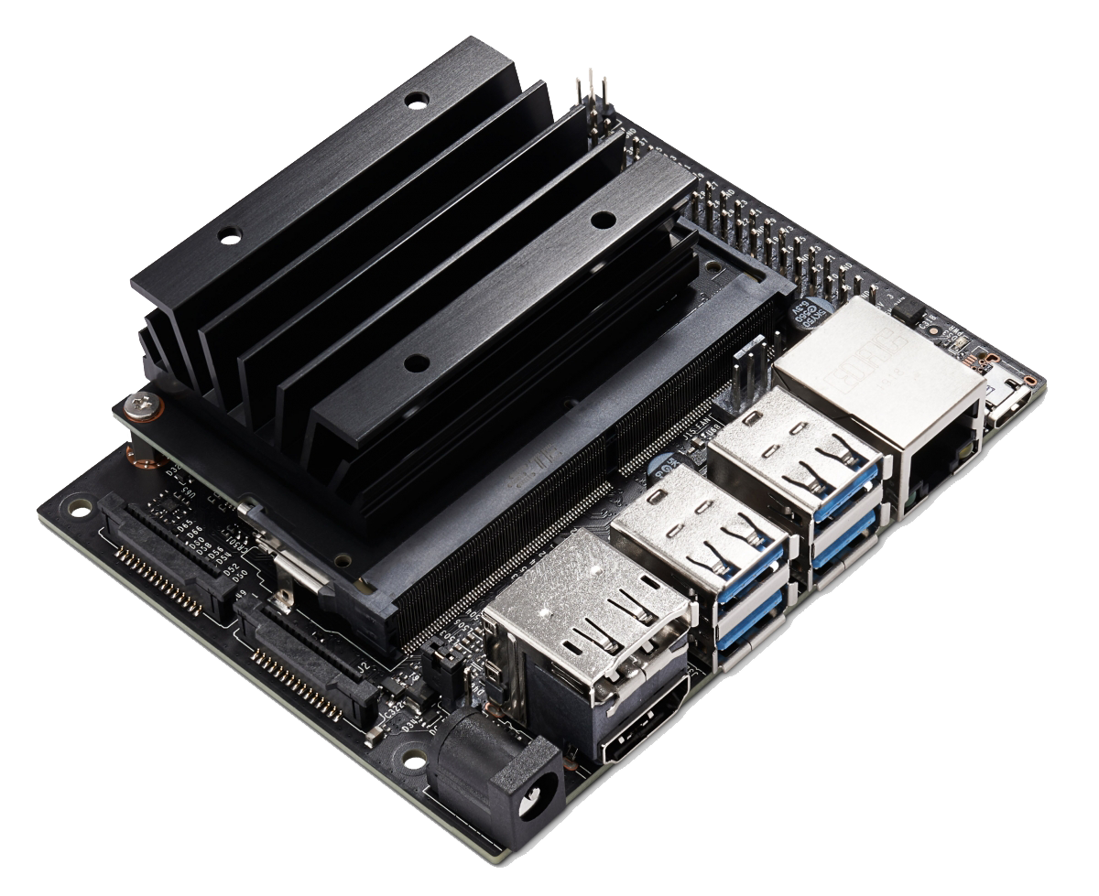
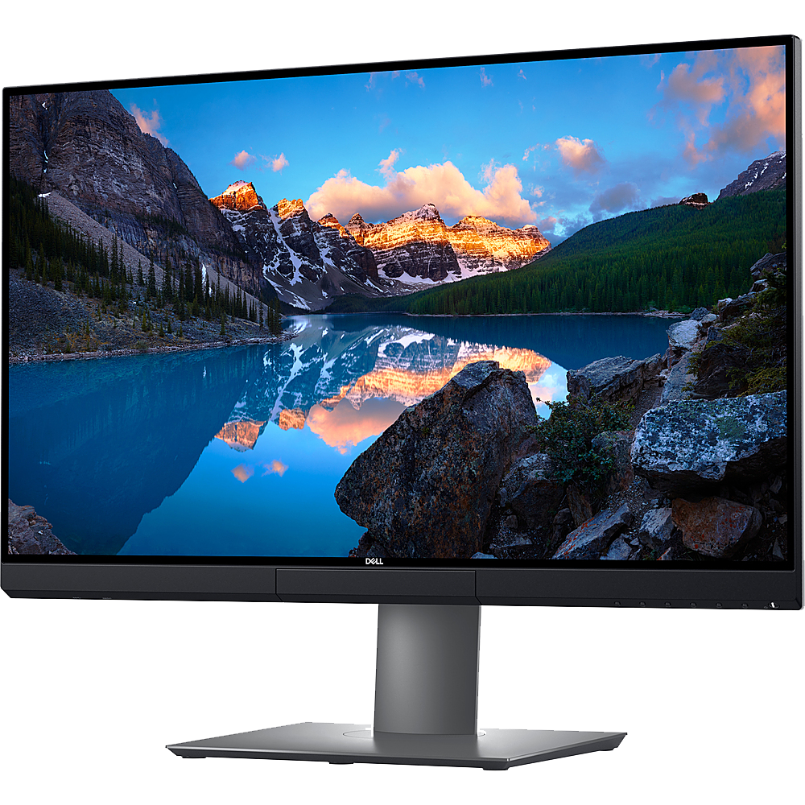
NVIDIA Jetson Nano
BLE
USB
Ribbon
HDMI

Slide 10
Materials
STMicroelectronics SensorTile*
Camera
Computer –or– NVIDIA Jetson Nano**
* Soldered to Cradle Board
** WiFi + BLE card, display, and speakers required

Slide 11
Engine

Slide 12
Overview
Audio DSP engine
Modular synthesizer component approach
Renders uncompressed audio files

Slide 13
Components
Oscillator
4th-Order Low-Pass Filter
ADSR Envelope Generator
Mixer
Long-Delay Effect
Reverb Effect

Slide 14
Signal Flow
Oscillator
Filter
Mixer
Reverb
Mapped to Gain Multiplier
Stereo Output to DAC
ADSR
Delay

Slide 15

Data-Driven Design
Scales defined as numeric series
BPM and subdivisions set as multipliers to control loop rate
$Hz=base_Hz ∗2^{({scale_step}/{12})}$

Slide 16
Controllers

Slide 17
SensorTile

Slide 18
Overview
9-Degrees of Freedom Inertial Measurement Unit (9-DOF IMU)
Data transmission via BLE GATT
Motion and Quaternion characteristics*
10,000Hz** notification sample rate
* Recorded data logs
** 10ms

Slide 19
Data Processing
No Data Pre-Processing
Calculation of Spherical Coordinates based on Acceleration
Calculation of Euler Angles based on relative Quaternions*
* Quaternions were calculated from the initial relative quaternion ($q_{0}=1, q_{1}=0, q_{2}=0, q_{3}=0$), computing changes in the real value ($q_{0}$) by normalizing against the vector quaternion (i.e., imaginary components).

Slide 20

Spherical Coordinates – Motion
Radial Distance $ρ = \sqrt{x^{2}+y^{2}+z^{2}}$
Polar Angle $θ=arccos⁡\left(\frac{acc_z}{ρ}\right)$
Azimuth Angle $φ=arctan\left(\frac{acc_y}{acc_x}\right)$

Slide 21

Mapping of Spherical Coordinates
$ρ$ – ADSR Attack*, ADSR Amp. Multiplier, ADSR Duration*, Delay mixer channel volume
$θ$ – LPF Cutoff Frequency
$φ$ – Reverb Dry/Wet Balance
* Inverse Proportion

Slide 22

Euler Angles – Quaternions
Roll $φ =arctan\frac{2(q_{0}q_{1}+q_{2}q_{3})}{1−2({q_{1}}^{2}+{q_{2}}^{2})}$
Pitch $θ=arcsin⁡(2\left(q_{0}q_{2}−q_{3}q_{1}\right))⁡$
Yaw $ψ=arctan\frac{2(q_{0}q_{3}+q_{1}q_{2})}{1−2({q_{2}}^{2}+{q_{3}}^{2})}$

Slide 23
Computer Vision

Slide 24
Overview
Custom GUI
Hand recognition

Slide 25
GUI Elements
Buttons
Slider
Toggle
Menu

Slide 26
Hand Recognition
Index fingertip extraction
Conversion to 2D point
Bounding boxes around GUI elements
AABB 2D collision detection

Slide 27
Data Analysis

Slide 28
Overview
Search correlations in the data logs
Found and graphed correlations
High correspondence in acceleration data
Identification of non-linear trigonometric identities
Quaternion evaluation

Slide 29
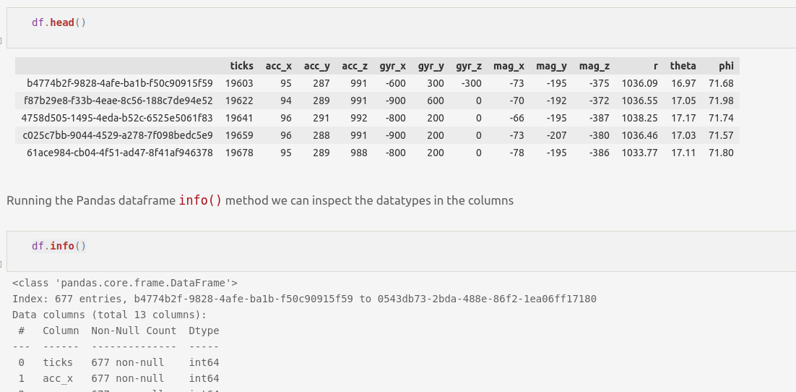
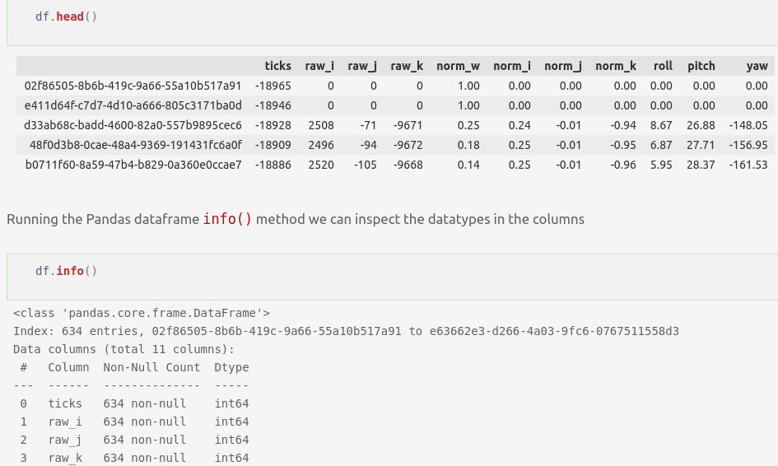
Preparation
Data was well formatted and consistent, so clean up was not required

Slide 30
Processing
Search for highest correlations
Graph correlations to look for visual patterns
Run Linear Regression on highest correlations
Search data with neural networks

Slide 31
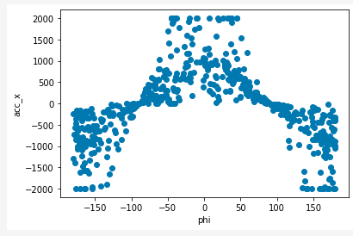
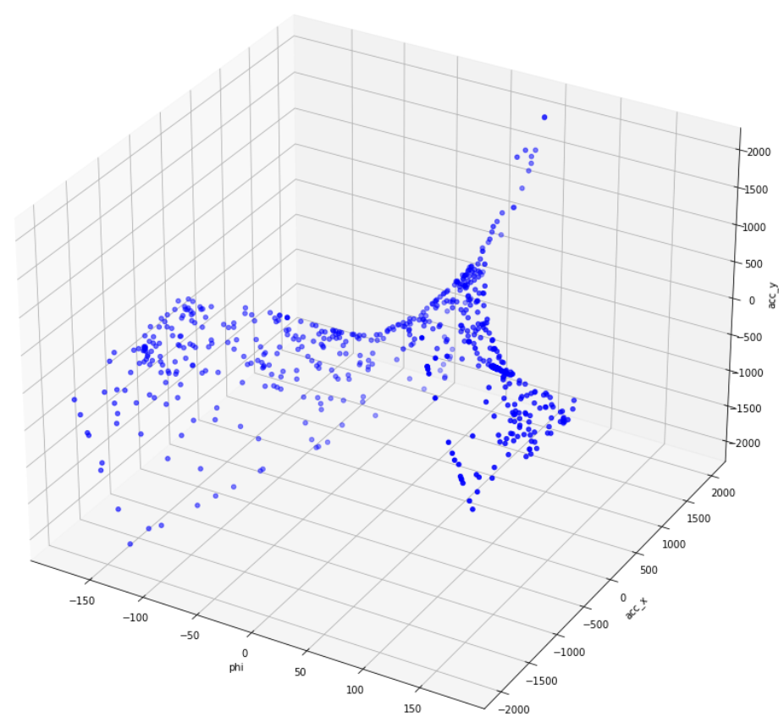
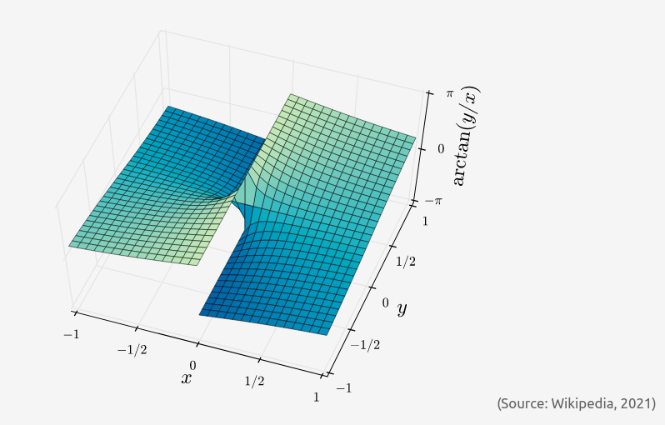
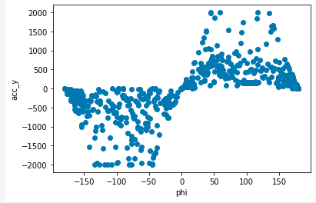
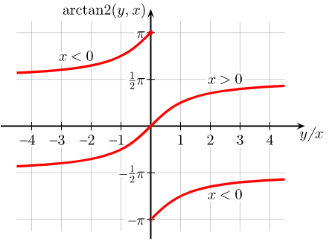
Visualization – Motion

Slide 32
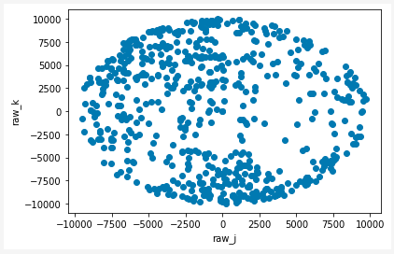
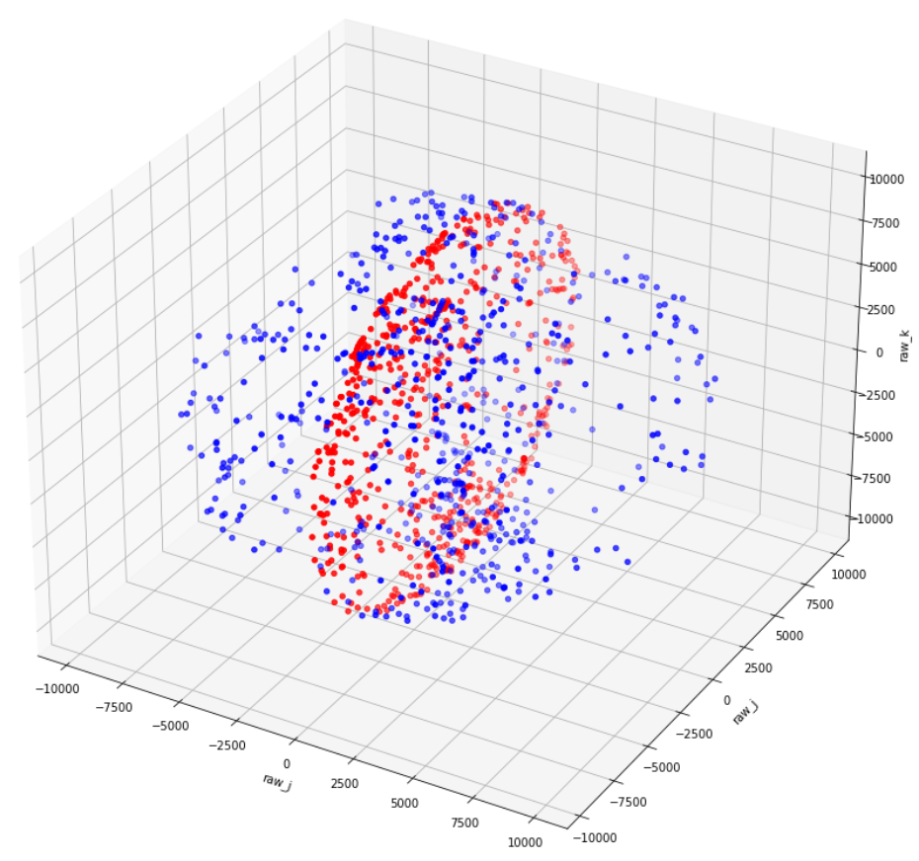
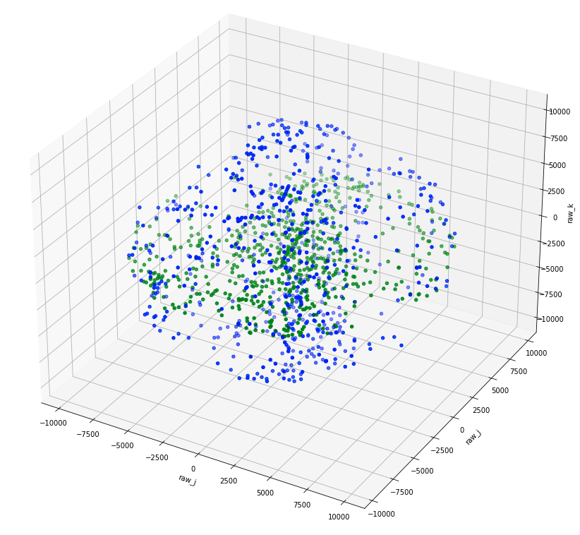
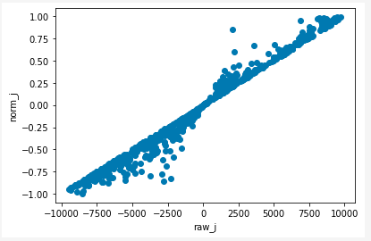
Visualization – Quaternions

Slide 33
Observations
Gathered data demonstrates non-linearity
Graphing data in various perspectives assists in determining non-linearity
Quaternions seem to indicate a better foundation for machine learning

Slide 34
Resources

Slide 35
Python Libraries
AsyncIO – Asynchronous concurrent code
Threading – Thread-based parallelism

Slide 36
Third-Party Libraries – Synth
Bleak – BLE cross-platform connectivity
MediaPipe
Numpy
OpenCV
Pandas
Pyo – Audio DSP
Shapely – Analysis of planar geometric objects

Slide 37
Third-Party Libraries – Analysis
Jupyter Notebooks
MatPlotLib
Numpy
Pandas
Sci-Kit Learn – Machine learning and correlations
TensorFlow and Keras

Slide 38
Conclusions

Slide 39
Conclusions
STCV-Synth offers great performance capabilities
IMU sensors and computer vision offer remarkable performance possibilities for artists and non-artists alike
Alternative controllers open universal possibilities for creative expression
Trigonometric functions and quaternions are powerful tools for describing motion

Slide 40
Conclusions
Quaternions are optimal for data analysis and machine learning
Hardware and firmware limitations in microcontrollers are constraining and more apt to low-level languages
Image processing is better suited for multi-processor capable languages
MediaPipe offers better and more efficient results than custom trained models

Slide 41
Future – Features
Polyphony
Euler angles based musical gestures
Sustain mode
Multi-sensor operation

Slide 42
Future – Optimization
Improve OpenCV execution
Decouple async queues for real-time improvements
Cross-platform GPU acceleration
Port to multi-thread compatible language

Slide 43
Next Prototype
Video synthesizer engine
EEG controller

Slide 44
Thanks!

